Slide 1

Full-Stack On-Premise Data Pipeline for IoT & Weather Data
This project showcases the design and implementation of a comprehensive on-premise data pipeline tailored for a weather analytics company. The pipeline handles both real-time and historical data, providing a robust solution for data ingestion, transformation, storage, and monitoring.

Slide 2

Project Overview
Objective: To build a complete data pipeline for weather and IoT data, focusing on ingestion, transformation, storage, and monitoring.
Data Sources: Real-time data from weather APIs; simulated batch data.
Orchestration: Apache Airflow manages all components.
Monitoring: Grafana provides system health and pipeline metrics.
Future Integration: Designed for seamless integration with machine learning and analytics platforms.

Slide 3

Problem Statement
The weather analytics company faces the challenge of integrating heterogeneous data sources and processing data in real-time and batch modes. Maintaining data consistency, enabling automation, and ensuring observability are critical.
Integrating Heterogeneous Data Sources
Real-time vs Batch Processing Synchronization
Maintaining Data Consistency
Enabling Automation and Observability

Slide 4
Key Technologies
Python
Scripting, API integration, Faker simulation
Apache Kafka
Real-time ingestion pipeline
Apache Spark
Batch and streaming data transformation
Apache Hive
Data Lake for structured reporting
MySQL
Traditional structured data storage
Apache Airflow
Workflow orchestration and job scheduling
Docker Compose
Containerization of services (optional)
Grafana + Prometheus
System and pipeline monitoring
This combination ensures a modular, scalable, and efficient data processing system.

Slide 5




Ingestion Layer
Weather API to Kafka
CSV Generation via Faker
MySQL Data Mocking
Python script pulls weather data from OpenWeatherMap API every minute, sending it to a Kafka topic.
Simulates user sensor logs, saving to a new CSV file every minute.
Generates fake historical or device metadata, inserting it into a MySQL table.

Slide 6
Processing Layer
Spark Streaming
Spark Batch ETL
Consumes data from Kafka, writing streaming weather data into Parquet files every 5 minutes.
Reads CSV files and MySQL tables, joining datasets and applying transformations. Outputs results into a Hive table and a MySQL table.

Slide 7




Loading & Storage
Parquet Files
Output from Spark Streaming, stored locally or in HDFS, efficient for big data queries.
Hive Table
Used for analytical queries and data exploration, supports export to CSV.
MySQL Table
Stores post-ETL cleaned and joined data for integration with external applications.

Slide 8
Orchestration & Monitoring
Orchestration with Apache Airflow
Monitoring with Grafana & Prometheus
Schedules and runs weather_to_kafka_dag.py (API ingestion)
Job success/failure status
Kafka consumer lag
Schedules and runs batch_etl_dag.py (ETL processes)
Resource utilization (CPU, memory)

Slide 9
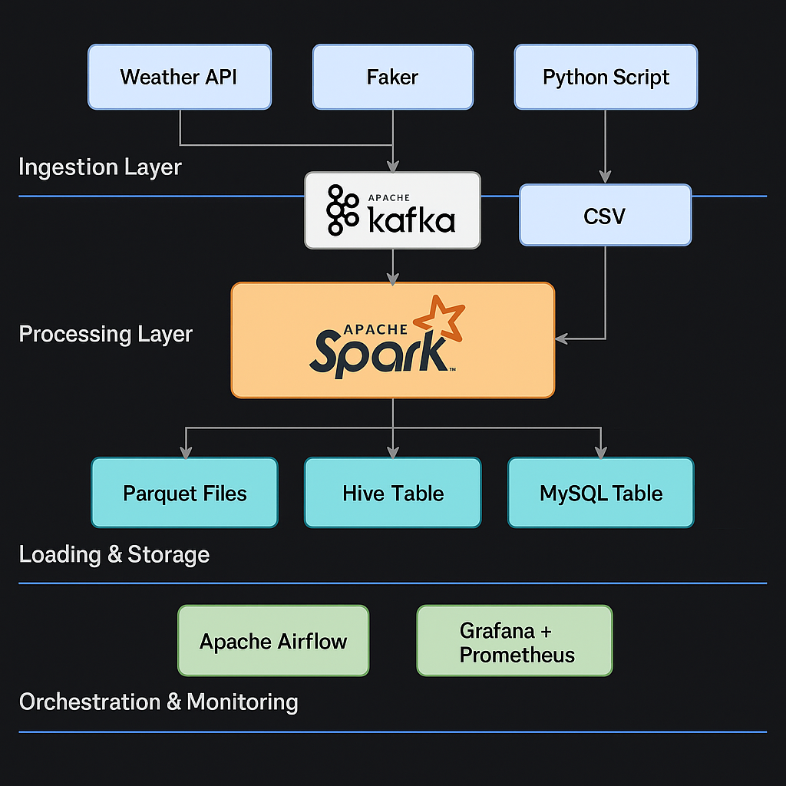
Key Deliverables
Code Repository (GitHub): Kafka producers, Faker scripts, Spark jobs, Airflow DAGs, Docker files.
Airflow DAGs: weather_to_kafka_dag.py and batch_etl_dag.py.
Spark Jobs: Streaming (streaming_kafka_to_parquet.py) and Batch (batch_etl.py).
Hive SQL Scripts: For table creation and CSV export.
README.md: Complete documentation with setup, usage instructions, and examples.

Slide 10
Conclusion
This on-premise data pipeline project provides a robust and scalable solution for weather analytics. It demonstrates the power of open-source tools in building a complete data engineering system.
Key Skills Acquired
Python, SQL
Kafka, Spark, Hive
Airflow
Grafana, Prometheus

